Slide 1
Crack Nucleation and Propagation
ME-255
Principles of tribology
Bharat
ME-08389
Oct 29, 2012

Slide 2
Organization of Presentation
Basic fracture types
Stress temperature curves
Nucleation of Cleavage Cracks
Propagation of Cleavage Cracks
Effect of Grain Boundaries
Effect of State of Stress
Fracture diagram

Slide 3



Basic Fracture Types
Shape of
Original
specimen
Brittle
fracture
Ductile
fracture

Slide 4
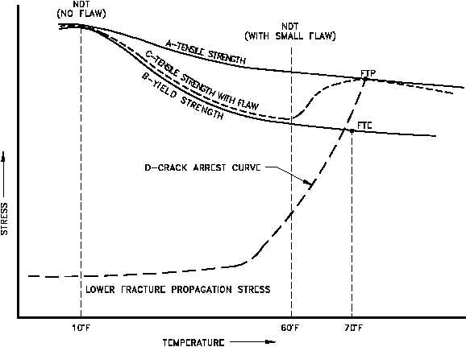
Stress Temperature Curve For Crack Initiation And Propagation

Slide 5
Nucleation of Cleavage Cracks
Two stages in the formation of Cleavage Crack
Nucleation (Controlled entirely by local stresses around slip or twin bands)
Growth (Governed both by the applied stress acting on the solid and local stresses)
For Polycrystalline metals
Growth
Growth of crack across
An individual grain
Propagation of a grain size
Cleavage crack through
the complete solid

Slide 6
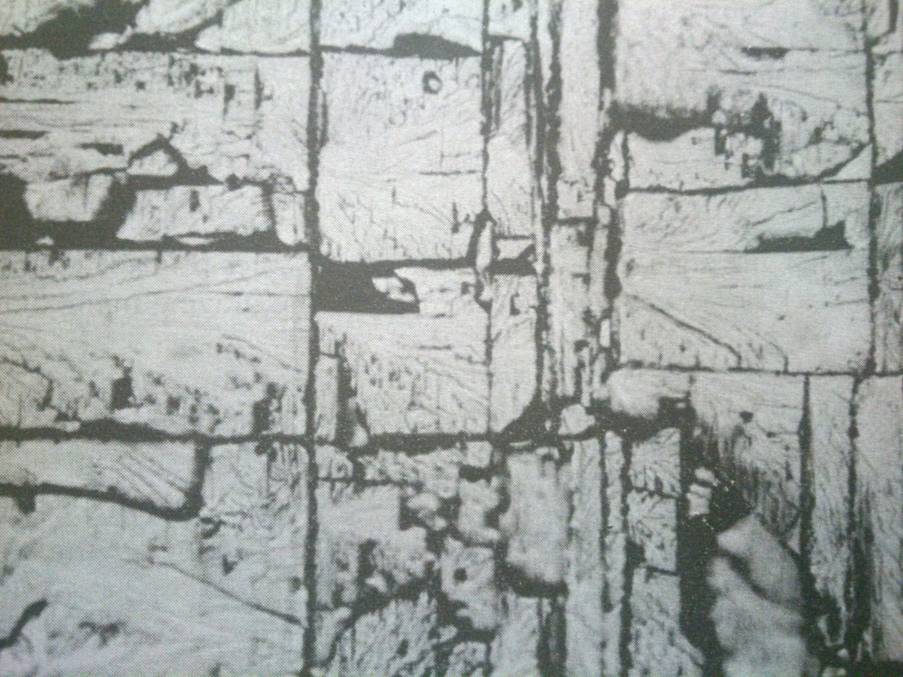
Nucleation of Cleavage Cracks

Slide 7
Nucleation of Cleavage Cracks
Metals don’t fracture as a result of pre-existing Griffith cracks.
Cleavage cracks nucleated by stress concentration produced by inhomogeneous plastic-deformation.
Fracture front moves across the specimen discontinuously, being impeded by the twins that form in front of it.
Crack has to be continuously renucleated on the far side of the twins in order to keep on moving.

Slide 8
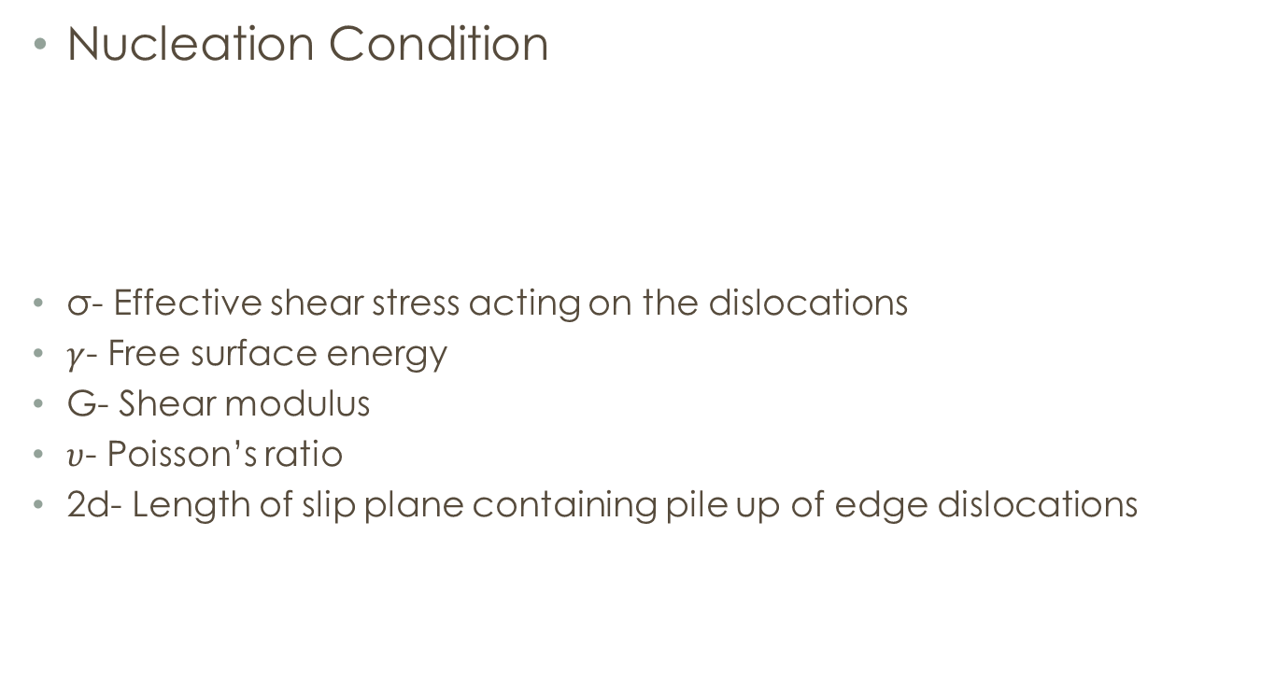

Nucleation of Cleavage Cracks
Nucleation Condition
σ- Effective shear stress acting on the dislocations
$γ$- Free surface energy
G- Shear modulus
$υ$- Poisson’s ratio
2d- Length of slip plane containing pile up of edge dislocations
$$σ=\sqrt{\frac{4γG}{π(1−υ)d}}$$

Slide 9
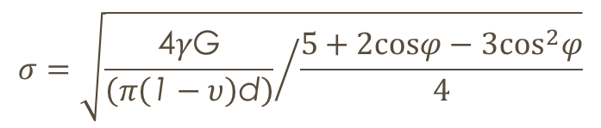
Nucleation of Cleavage Cracks
Nucleation of a cleavage crack along a plane tilted at an angle φ to that containing a pile up of edge dislocations:
$$σ=\sqrt{{\frac{\text{4}γ\text{G}}{\left(π\left(\text{1}−υ\right)\text{d}\right)}}/{\frac{5+2cosφ−3\cos^{2}φ}{4}}}$$

Slide 10
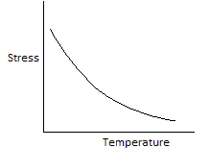
Nucleation of Cleavage Cracks
Important to consider the effect of temperature on the critical resolved shear stress.
In BCC metals, e.g. iron, the temperature dependence of critical resolved shear stress for slip is very large.

Slide 11
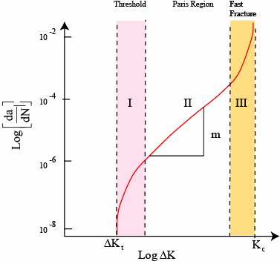
Regimes of Crack Propagation
Stage I: crack growth
Average crack growth
< one lattice spacing
Stage II: crack growth
& fatigue striations:
Paris law application
Stage III: Fast crack growth:
catastrophic failure!
Regions I, III – very sensitive
to metallurgical variables,
test conditions

Slide 12
Propagation of Cleavage Cracks
Two Approaches
Griffith approach (Energy based)
Inglis approach (Stress based)

Slide 13
Griffith Approach
When crack grows
ΔU →

Slide 14
Contd…
Griffith approach gives,

Slide 15
Propagation of Cleavage Cracks
Condition for crack propagation
K ≥ K_{c}
All brittle materials contain a population of small cracks and flaws that have a variety of sizes, geometries and orientations.
When the magnitude of a tensile stress at the tip of one of these flaws exceeds the value of this critical stress, a crack forms and then propagates, leading to failure.
Stress Intensity Factor:
--Depends on load & geometry.
Fracture Toughness:
--Depends on the material,
temperature, environment &
rate of loading.

Slide 16
Propagation of Cleavage Cracks
K=
Where, K- Stress intensity factor
a- length of surface crack or ½ length of internal crack
Y- dimensionless parameter

Slide 17
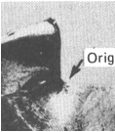
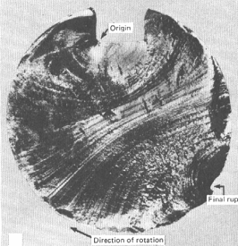
Propagation of Cleavage Cracks
Crack grows incrementally
typ. 1 to 6
increase in crack length per loading cycle
crack origin
• Failed rotating shaft
-- crack grew even though
K_{max} < K_{c}
-- crack grows faster as
• Δ σ increases
• crack gets longer
• loading freq. increases.

Slide 18
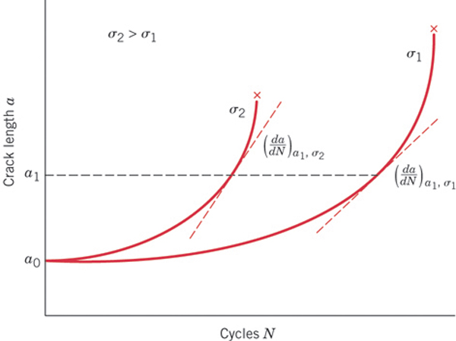
Crack Growth Rate
Initially, growth rate is small, but increases with increasing crack length.
Growth rate increases with applied stress level for a given crack length (a₁).

Slide 19
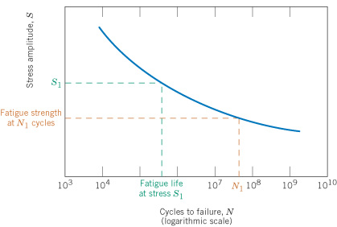
S-N Curves
A specimen is subjected to stress cycling at a maximum stress amplitude; the number of cycles to failure is determined.
This procedure is repeated on other specimens at progressively decreasing stress amplitudes.
Data are plotted as stress S versus number N of cycles to failure for all the specimen.
Typical S-N behavior: the higher the stress level, the fewer the number of cycles.

Slide 20
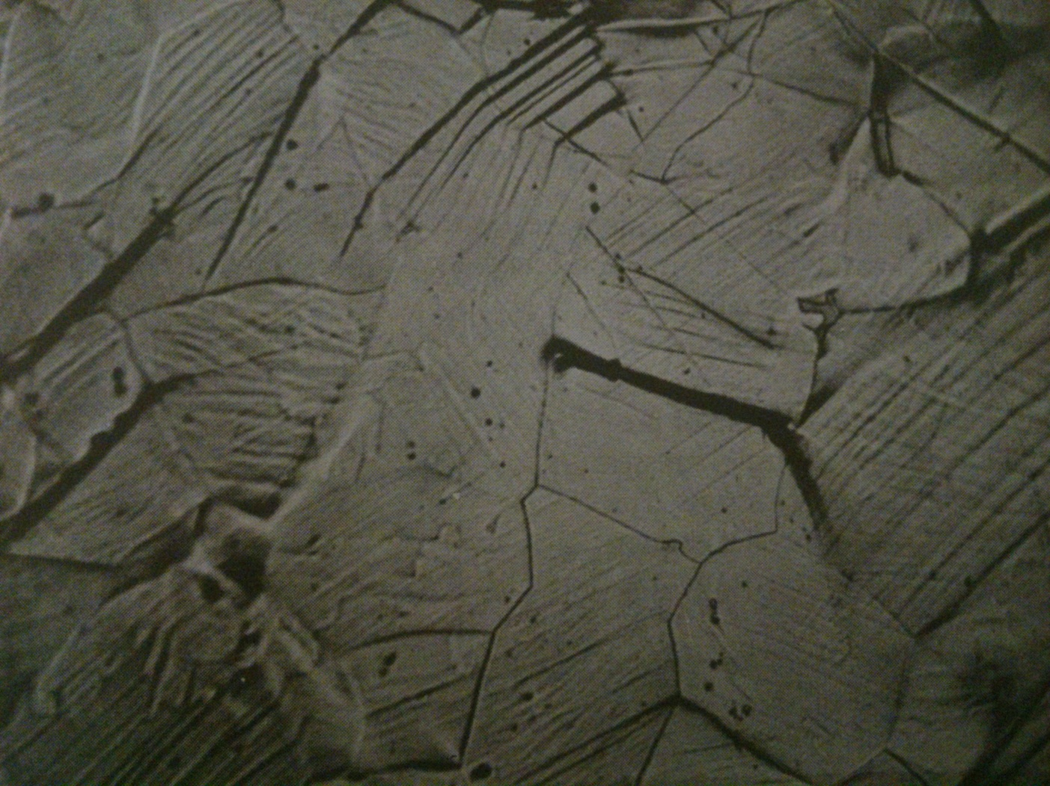
Effect of Grain Boundaries

Slide 21
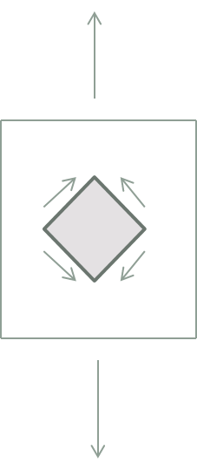
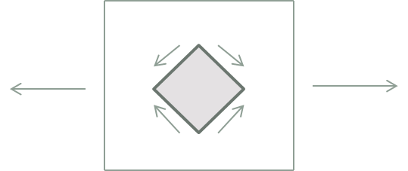
Effect of State of Stress
Large tensile stresses and small shear stresses favor cleavage.
σ
σ
σ
σ

Slide 22
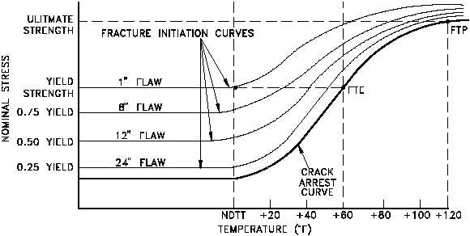
Fracture Diagram

Slide 23
References
Hahn, G.T., Averbach, B. L., Owen, W. S., and Cohen, M., ‘Fracture’
Biggs, W. D. and Pratt, P. L., ‘Deformation and fracture of alpha-iron at low temperatures’
Robert E. Reed-Hill, ‘Principles of Physical Metallurgy’
E. Smith, ‘Nucleation of Cleavage Cracks in Solids – Fracture at Screw Dislocation Pile-ups’
http://nuclearpowertraining.tpub.com/h1017v2/css/h1017v2_38.htm

Slide 24

Thanks for your kind attention

